Slide 1

“Final Review of Major Project”
for E-4 SEM - 2 2017 Admitted Batch
Submitted as part of Major Project.
M. Bhargavi (S171051)
B. Devaki (S170283)
P. Vinay kumar (S170528)
Under the Supervision of:
Ms. M. Roopa
Assistant Professor
Department of Computer Science and Engineering
Rajiv Gandhi University of Knowledge Technologies
Srikakulam – 532402

Slide 2
Extraction of Fashion Trends from Social Media Data using Selenium Automation

Slide 3

SYSTEM REQUIREMENTS:
Software Requirements:-
Technologies :- Python, Web driver, Selenium, Yolov3, Deep Neural Networks, OpenCV, Machine Learning, VGG16, Flask, HTML, CSS, Bootstrap.
Tools :- Python IDE, Google Colab.
It is supports for Windows, Mac, Linux etc.
Hardware Requirements:-
For Ram 4 GB minimum, 8 GB recommended and preferably higher.
For Hard-drive minimum 32GB and preferably higher.

Slide 4
ABSTRACT:
Nowadays fashion trends are changing day by day, so identifying fashion trends is very important because trend analysis helps understand how a business has evolved in various areas, especially research areas such as marketing where current business activities and practices take place. So, all we need is a place where trends are available. Social Networks have become an important environment for collective trends extraction. Currently, the most relevant and popular Social Networks are Instagram, Twitter etc. These were created to share posts, comments and opinions and that can now use to extract trending products, Which provide information on trending products that people are talking about, so the retailers can source them to meet their needs. In other words, if they offer a more popular product, a larger audience will be willing to buy it.

Slide 5
INTRODUCTION:
The extraction of fashion trends from social media typically involves using data mining and machine learning techniques to analyze user-generated content, such as photos, hashtags, and captions. Natural language processing (NLP) algorithms can be used to identify relevant keywords and phrases related to fashion and style, while computer vision techniques can be used to analyze images and identify patterns in clothing and accessories.
Once the data has been analyzed, fashion trend experts can use the insights gained to identify emerging fashion trends, popular styles, and changes in consumer preferences. This information can then be used by fashion retailers and designers to guide their product development, marketing strategies, and overall business decisions.

Slide 6
MOTIVATION OF PROJECT WORK:
The motivation behind this project is to provide an efficient and automated system to identify and extract current fashion trends from social media data. With the growth of social media platforms and the increasing influence of influencers, fashion trends are changing more rapidly than ever before. Identifying these trends can be a time-consuming and complex task, which can be challenging for the fashion industry, e-commerce platforms, and consumers.

Slide 7
By developing an automated system that can efficiently scrape, categorize, and label fashion images and determine the trend score of products using multiple parameters, this project aims to provide a solution to this problem. The system can save time and effort compared to manual methods and provide a quick and accurate way to identify and present current fashion trends to users.
The motivation behind this project is to help various stakeholders in the fashion industry stay up-to-date with the latest trends, improve customer experience, increase sales and revenue for e-commerce platforms, and provide valuable insights for researchers in the field of fashion and data analysis.

Slide 8
EXISTING METHODS
Google Trends is a website by Google that analyzes the popularity of top search queries in Google Search across various regions and languages. The website uses graphs to compare the search volume of different queries over time.
Amazon’s search suggest feature is a way to uncover trending product and category keywords.

Slide 9
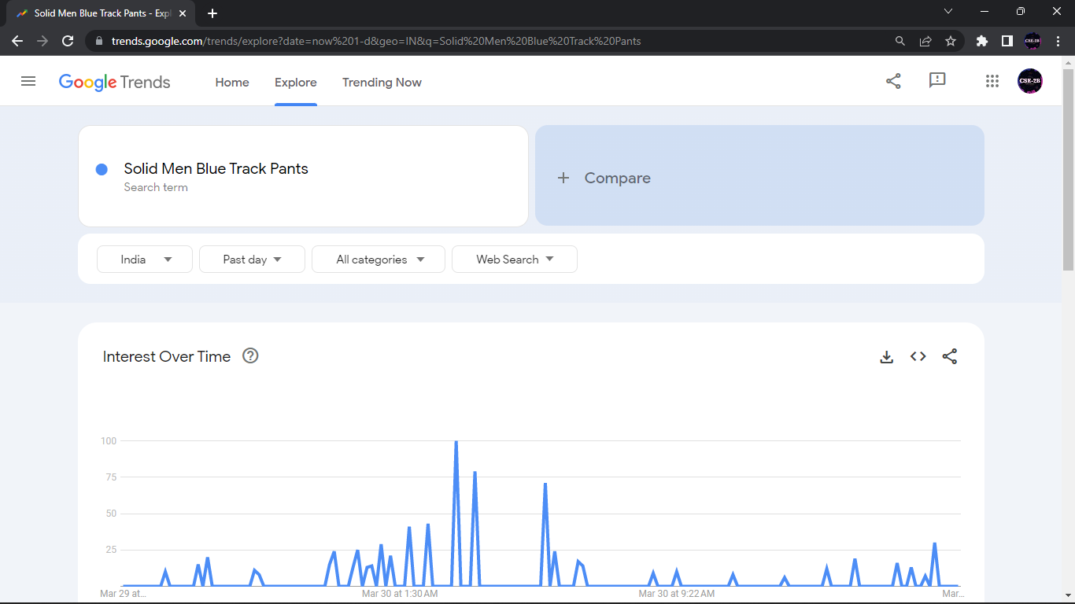

Slide 10
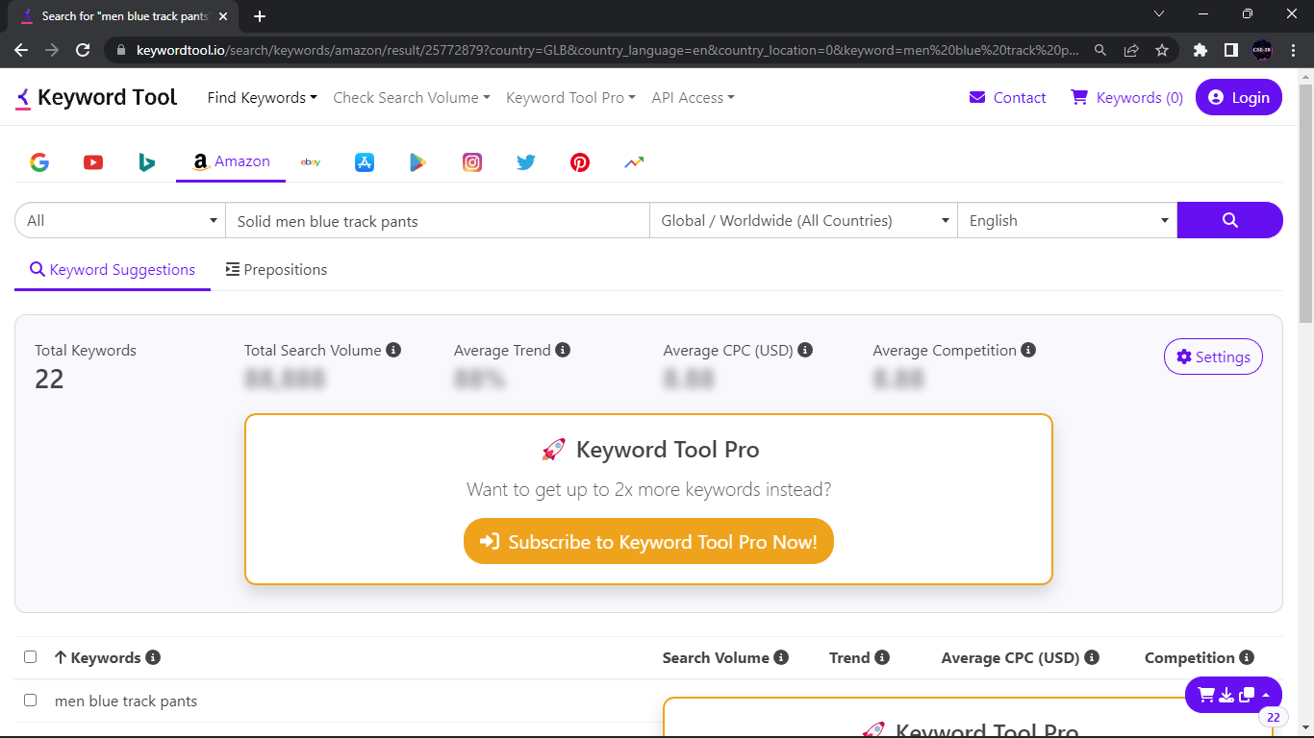

Slide 11
PROPOSED APPROACH:
A three-tier architecture is used, with the layers,
Crawling for Dataset Creation
Trends Identification and Classification
Flipkart Relevant Smart Mapper
A top view of the approach is shown on the image,

Slide 12
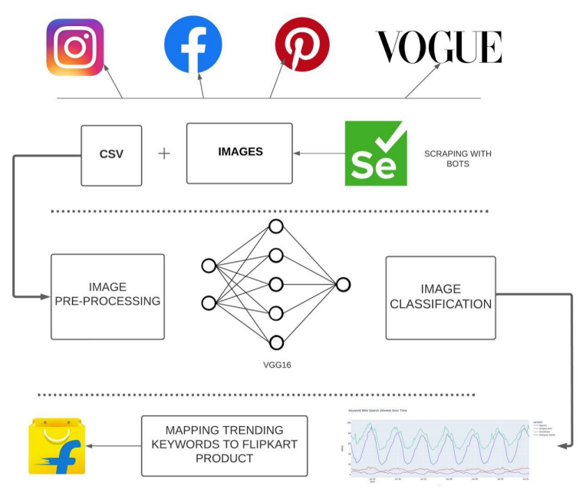


Slide 13
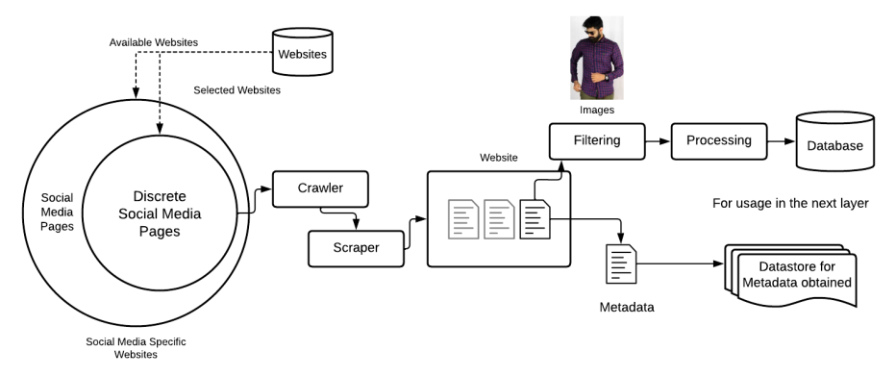
1. Crawling and Scraping
Crawling and Scraping social media websites for images and metadata. The workflow used for achieved this is displayed below.

Slide 14
2. Trends Identification and Classification
Crawling Trends Identification and Classification using a deep neural network based on the VGG16 architecture, and corroborating the trends with PyTrends API and Google Trends API.
• We make use of the VGG-16 architecture because it is one of the best models when it comes to image classifications, and consists of roughly 136 million parameters.
• As a result, we are able to classify and identify a large number of trends in the images – which can be easily scaled in the future.
• For images with unnecessary features such as human faces, arms, pets, etc., we use the YOLOv5 architecture to identify the “fashion” (clothes, footwear, etc.) and crop them out.
• We obtain the top trending fashion keywords from Google Trends API and PyTrends API and use it to corroborate/evaluate the result obtained.
• The described second tier is shown in the next slide

Slide 15
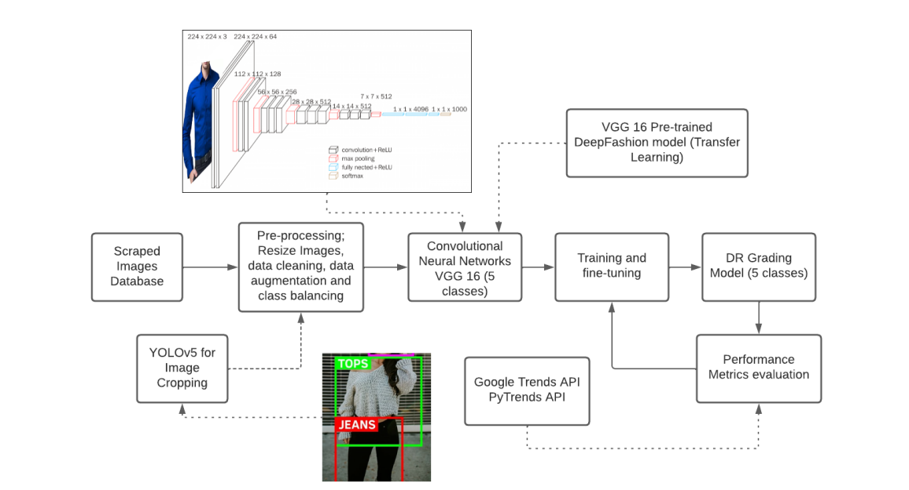

Slide 16
SCOPE OF RESEARCH WORK
Fashion Industry: The project can help the fashion industry to stay up-to-date with the latest trends in the market and adjust their inventory or production accordingly. This can also help them to stay ahead of their competitors.
E-commerce Platforms: E-commerce platforms can use this project to showcase the trending fashion products on their websites, which can increase their sales and improve the customer experience.
Consumers: Consumers can use the project to get quick and accurate information about the latest fashion trends and find out where to buy the products they are interested in.
Researchers: Researchers in the field of fashion and data analysis can benefit from this project by using the dataset and methodology to conduct further research in the area of fashion trends.

Slide 17
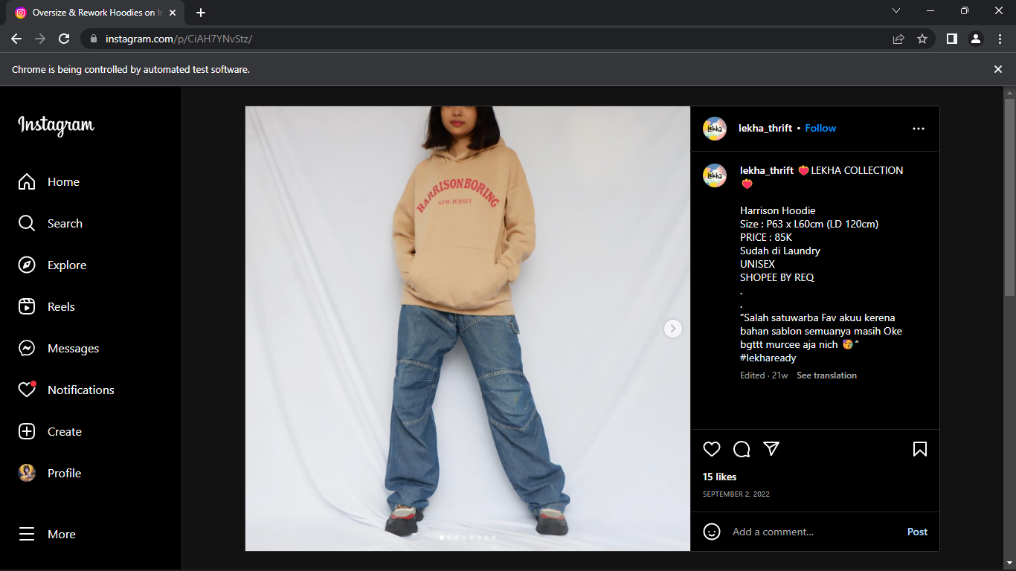
Screenshots of Output

Slide 18
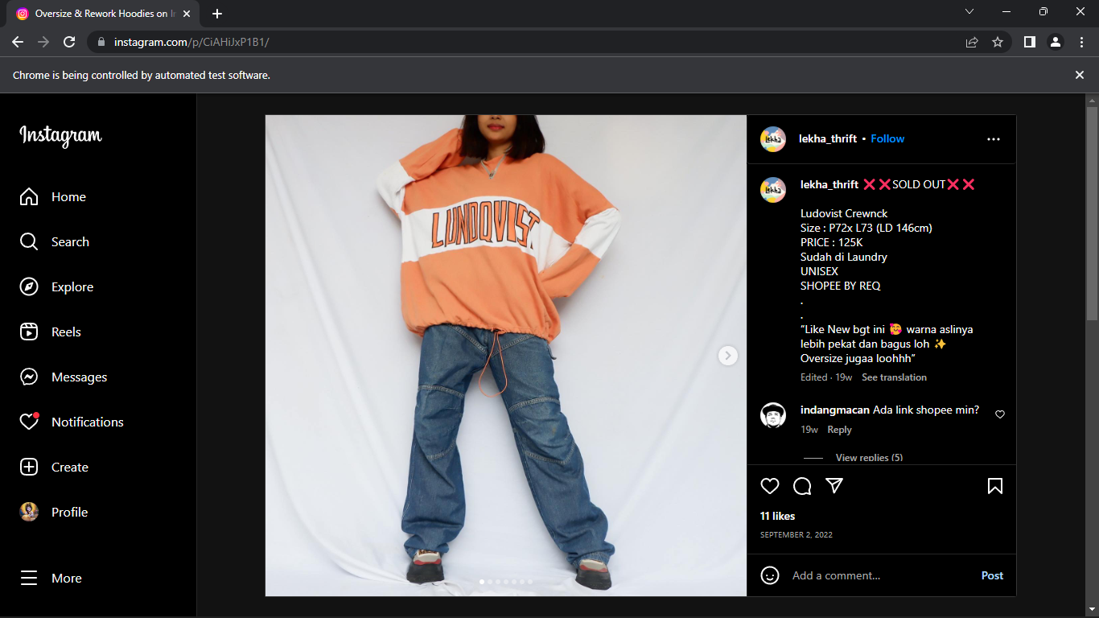

Slide 19
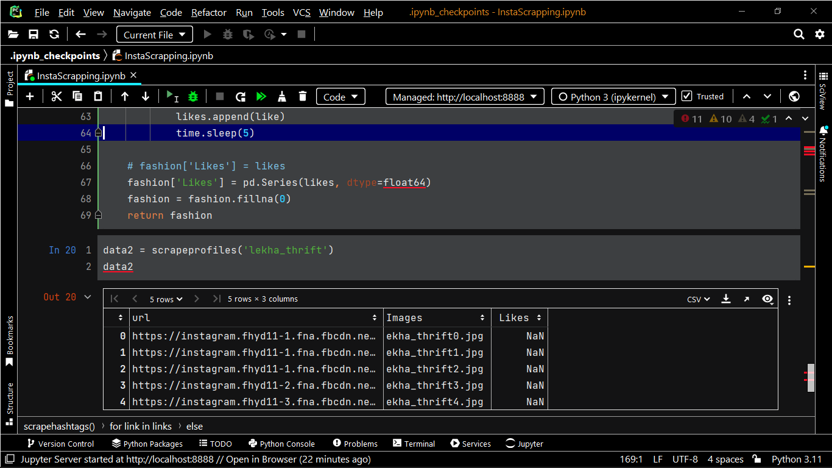

Slide 20
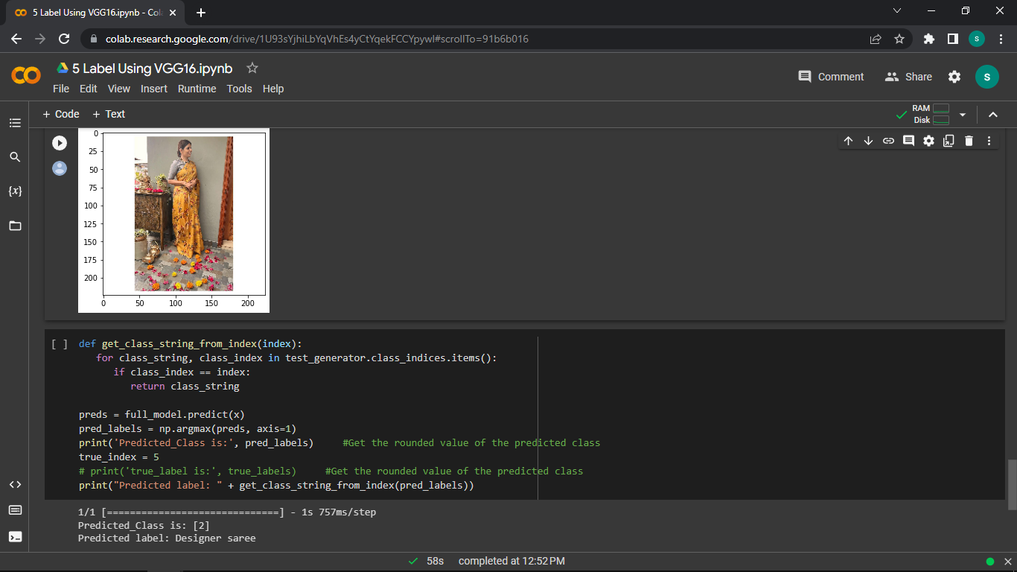

Slide 21
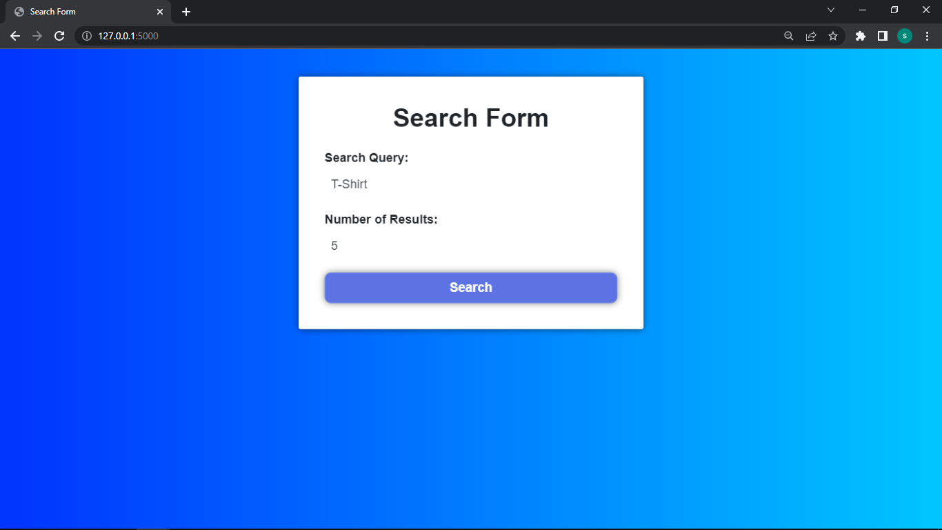

Slide 22
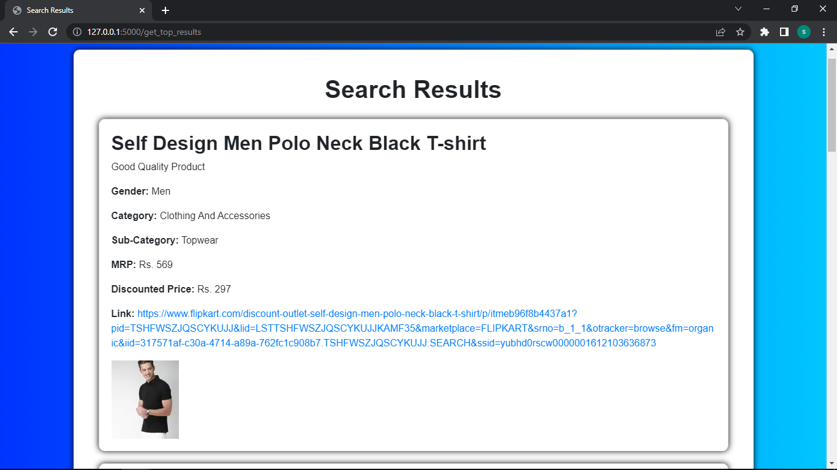

Slide 23
OUTCOMES:
Sample images and respective links
Category, sub category (Ex: Category - Fashion, sub category – Women Western)
Create a mapping of extracted trending keyword(s) with E-Commerce website category, sub category, vertical and product attribute(s), search page links
From a trending keyword, creating a corresponding searchable term on E-Commerce which will lead to matching products

Slide 24
CONCLUSION:
The conclusion of this project is that an automated system can be developed to identify and extract current fashion trends from social media data. The system can scrape fashion images from social media and blogs, remove unnecessary data using object detection, categorize and label the images, and determine the trend score of the products using multiple parameters including Google Trends.
The project has the potential to benefit various stakeholders including the fashion industry, e-commerce platforms, consumers, and researchers. The outcomes of the project include an automated system for trend identification, a categorized and labeled dataset, improved customer experience, improved sales for e-commerce platforms, and insights into fashion trends.

Slide 25
Overall, this project can provide an efficient and accurate way to identify and present current fashion trends to users, which can help the fashion industry to adjust their inventory or production accordingly, improve customer experience, increase sales and revenue for e-commerce platforms, and provide valuable insights for researchers in the field of fashion and data analysis.

Slide 26
Thanks!

